Slide 1
THE INNOVATIVE INNOVATORS
Chemistry & Biology game

Slide 2
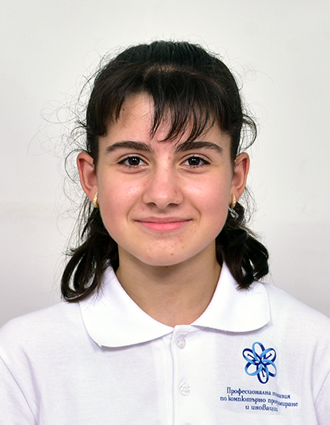
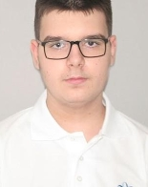
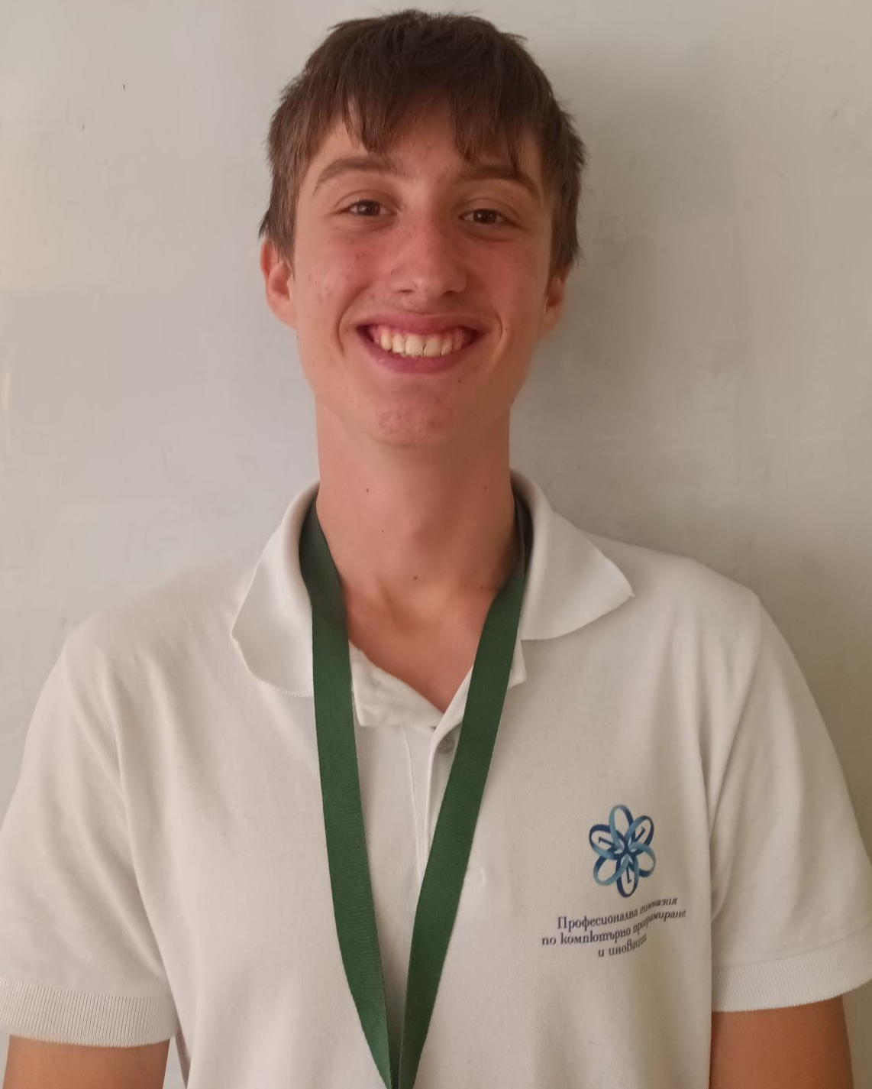
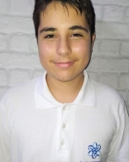
OUR TEAM
Iva Nedkova
Scrum trainer
Todor Ivanov
Back-end Developer
Bozhidar Dukov
Back-end Developer
Daniel Stefanov
Designer

Slide 3

OUR IDEA
The idea of our game is to educate the player on both biology and chemistry. The cell and viruses help to learn the cells in the human body and the questions help to learn the chemical elements.

Slide 4
STAGES OF REALIZATION
We chose the name of the team
We assigned roles
We created the logo
We made the README.md file
We wrote the code for the game
We created the presentation and the documentation

Slide 5










USED TECHNOLOGIES

Slide 6
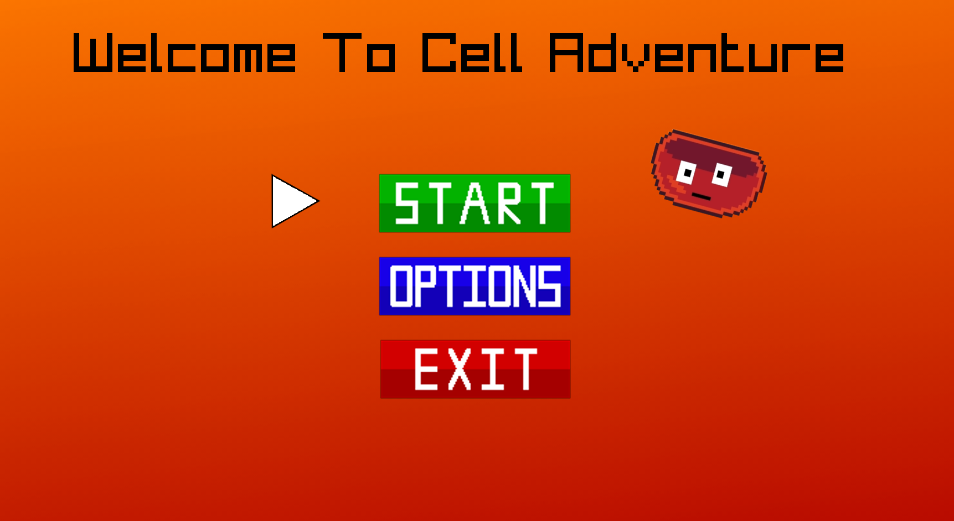
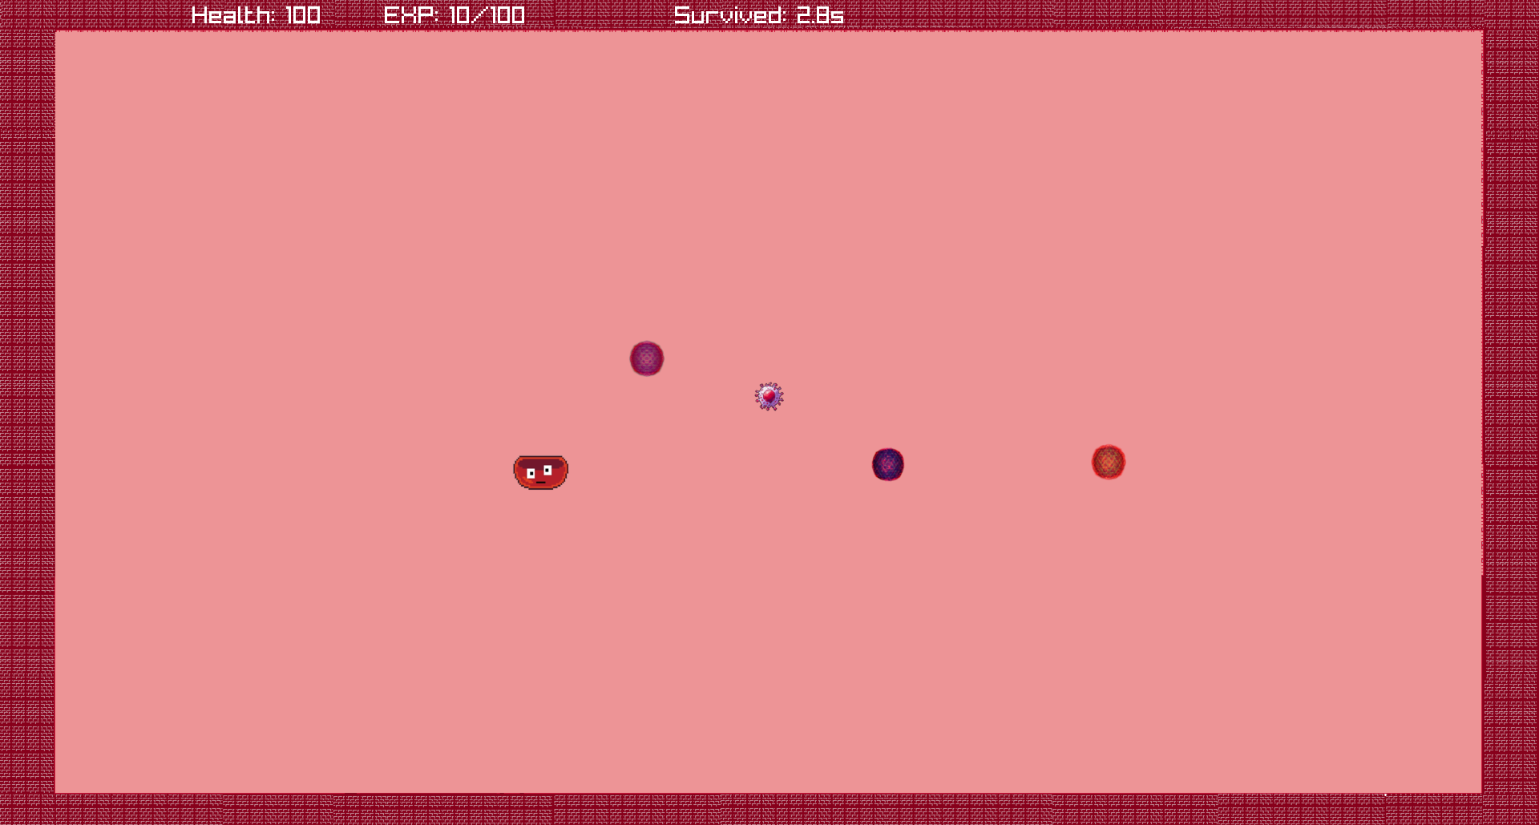
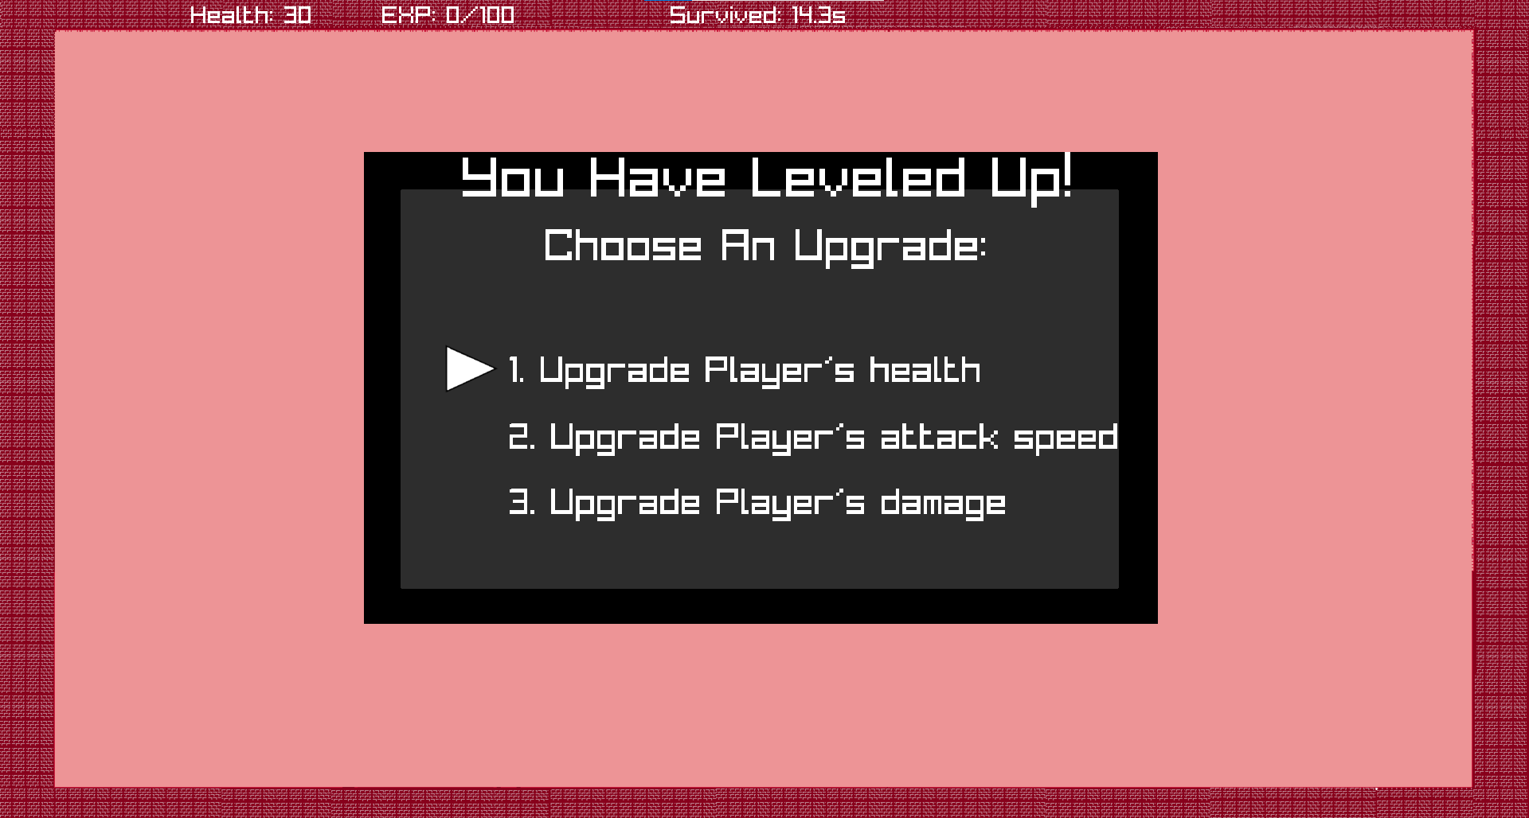
DEMO OF OUR PROJECT

Slide 7
Now let us guide you to our repository!

